Slide 1
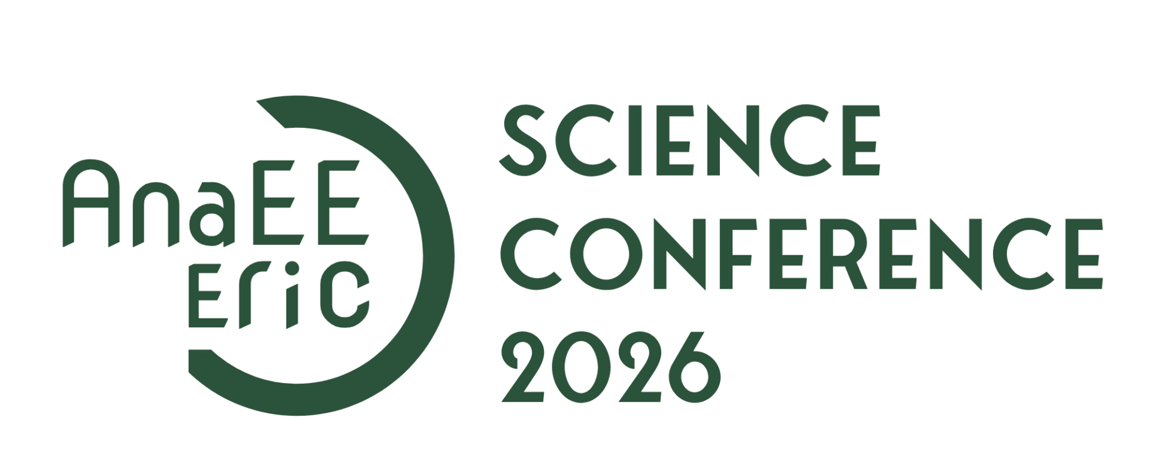

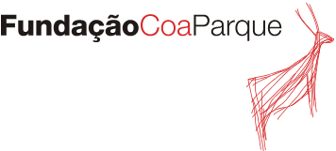
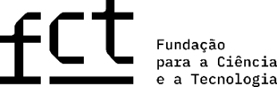
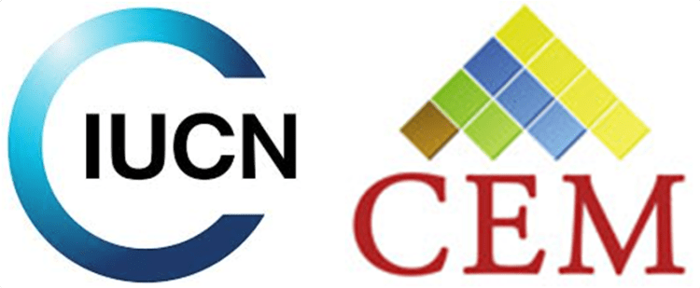
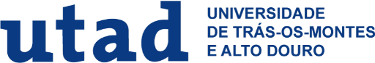

Agroecological Mosaics as Nature-based Solutions for Biodiversity and Production in Portugal’s Côa Valley
Mónica Q. Pinto,
Centre for the Research and Technology of Agro-Environmental and Biological Sciences (CITAB), University of Trás-os-Montes and Alto Douro (UTAD), Vila Real, Portugal
Advisors:
Edna Cabecinha,
CITAB, University of Trás-os-Montes and Alto Douro (UTAD), Vila Real, Portugal and IUCN, CEM, Lead of Nature-based Solutions Core Group
Simone Varandas,
CITAB), University of Trás-os-Montes and Alto Douro (UTAD), Vila Real, Portugal
Notes:
SPEAKER NOTES (Slide 1):
• Welcome everyone and thank you for joining this presentation on our research:
'Agroecological Mosaics as Nature-Based Solutions in the Côa Valley'.
• In this talk, we explore a crucial Mediterranean dilemma: how do we maintain agricultural yields
while conserving the rich biodiversity of areas like northern Portugal?
• We propose that traditional and organically managed agroecological mosaics are key to resolving
this trade-off, acting as essential Nature-Based Solutions (NBS).

Slide 2
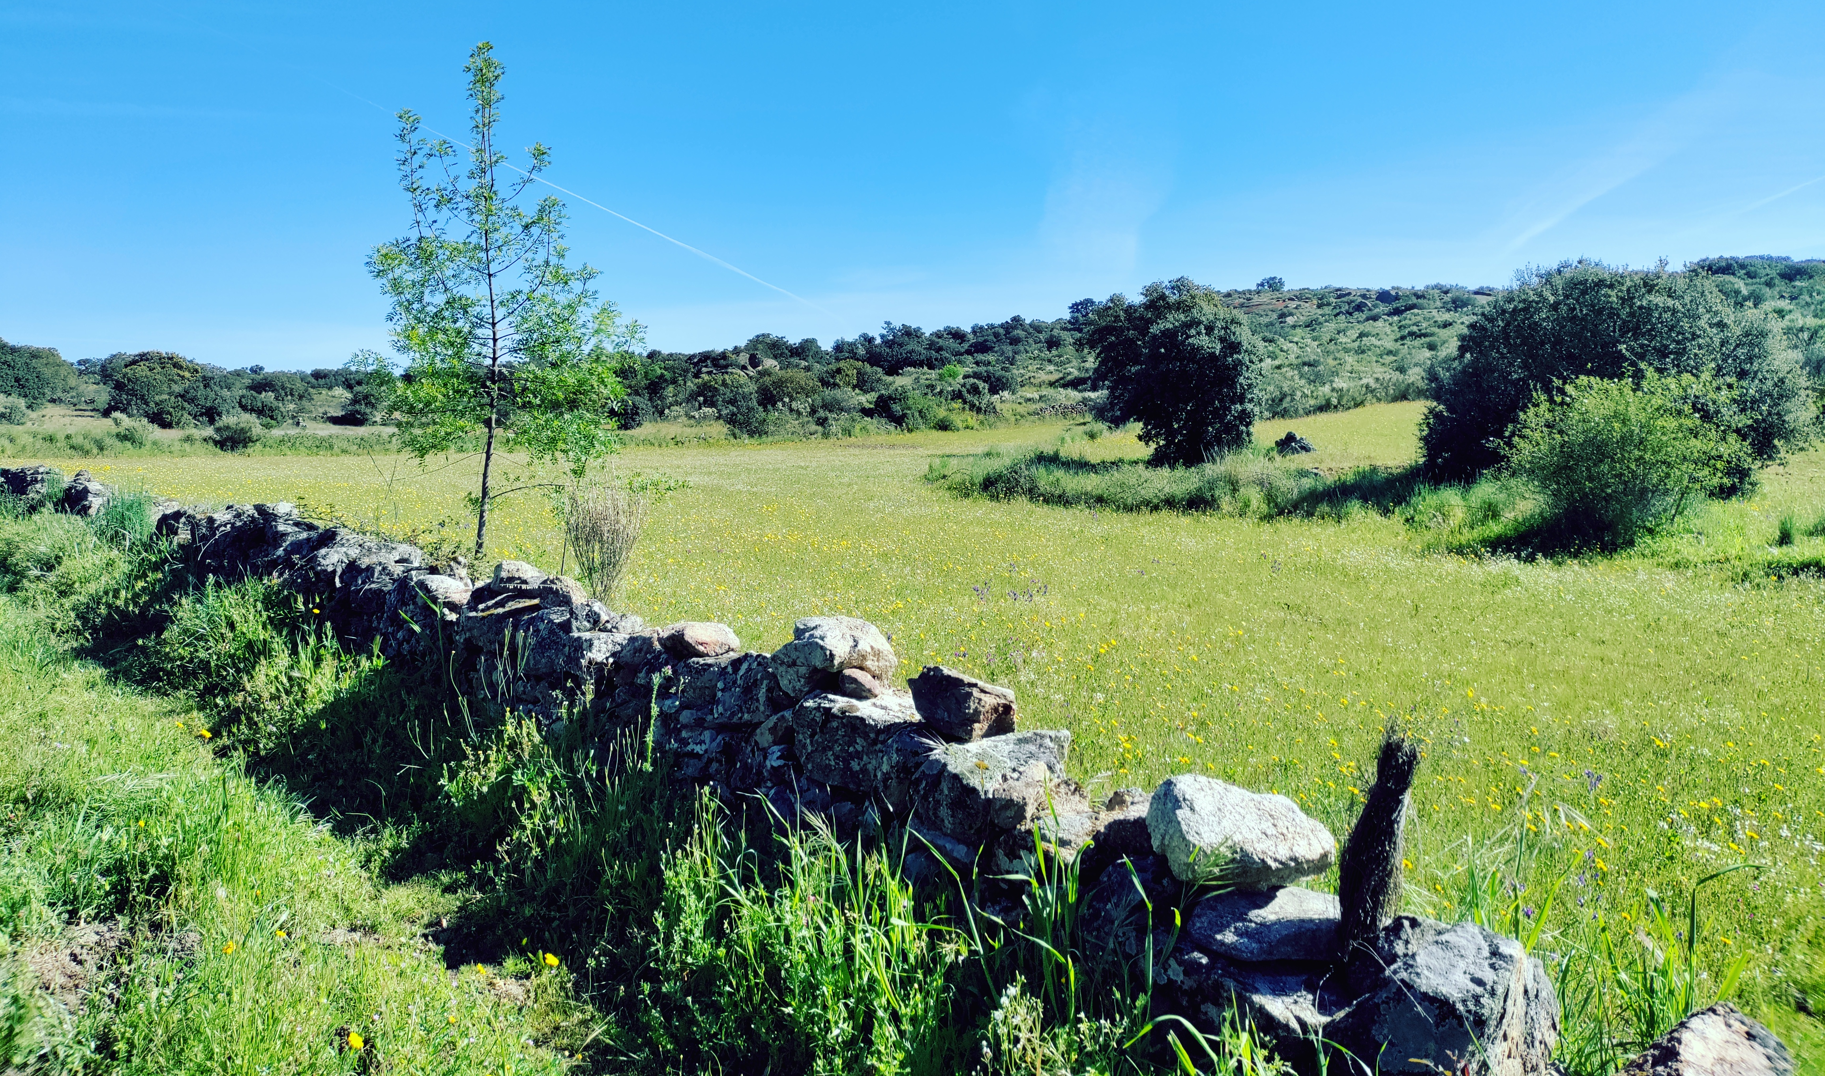
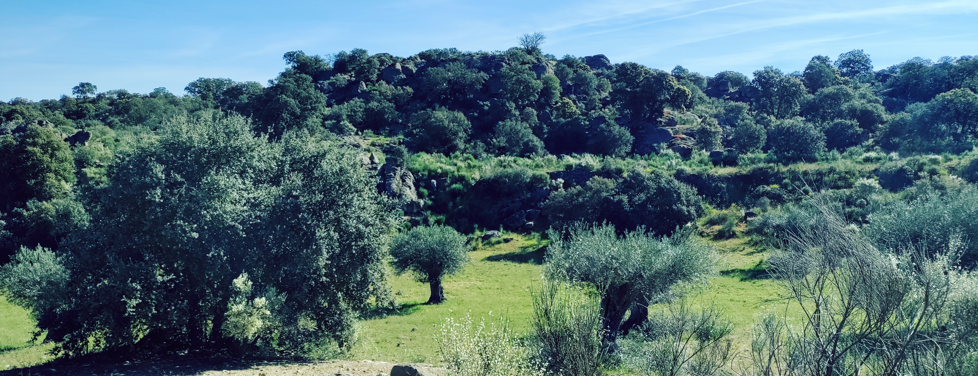
Landscape heterogeneity mitigates the severe conflict between conservation and production
02
The Mediterranean Agricultural Trade-Off
Conventional agricultural intensification leads to critical habitat fragmentation, triggering significant declines in native species and vital ecosystem services.
The Côa Valley as an Ecological Model
A unique socio-ecological transition zone in northern Portugal, characterised by steep topography, varying agricultural intensities, and rich rewilding initiatives.
Agroecological Mosaics as NbS
We hypothesise that heterogeneous, low-intensity agricultural mosaics act as natural networks, sustaining essential services like pollination and pest regulation.
Notes:
SPEAKER NOTES (Slide 2):
• Historically, agriculture and conservation have been viewed as conflicting goals.
• In the Mediterranean basin, agricultural intensification is the main driver of biodiversity loss.
• Our study area, the Côa Valley, represents a perfect landscape model: a mix of traditional low-intensity crops,
commercial intensive vineyards, and emerging wild, abandoned or rewilded habitats.
• We argue that managing this landscape as a heterogeneous 'mosaic' serves as a crucial Nature-Based Solution (NBS)
to restore connectivity and ecological balance without compromising local livelihoods.

Slide 3
Twelve months of multi-taxa monitoring tracked biodiversity across 13 distinct plots
03
13 Monitored Plots
(1 Hectare Each)
• Stratified Gradient:
Plots spanned traditional cork-oak forests (montados), olive groves, vineyards, and almond orchards.
• Land-Use Intensity:
Ranged from organic low-intervention systems to highly conventional, intensive monocultures.
3 Seasonal Campaigns
(2023 - 2024)
• Time & Seasonality:
Conducted extensive field sampling across Spring, Summer, and Autumn to capture biological cycles.
• Environmental Drivers:
Tracked seasonal microclimatic changes, water availability, and floral resource fluctuations.
Multi-Taxa Surveys
& Functional Mappings
• Multi-Taxa Surveys:
Systematic inventories of vascular plants (flora), insect predators, pollinators, and birds.
• Mappings:
Species mapped into functional guilds to quantify specific services: pollination, pest control, and seed dispersal.
Notes:
SPEAKER NOTES (Slide 3):
• To understand how these mosaics operate, we established a rigorous sampling protocol.
• We selected 13 distinct one-hectare plots representing a full gradient of agricultural intensity
and vegetation structure.
• We visited these plots during three seasons (Spring, Summer, and Autumn of 2023 and 2024) to account for seasonal variations.
• Importantly, we did not just look at one group of organisms. We conducted multi-taxa inventories—plants,
insects, and birds. This allows us to map ecological interactions and translate biodiversity data into
functional ecosystem services using IUCN guidelines.

Slide 4
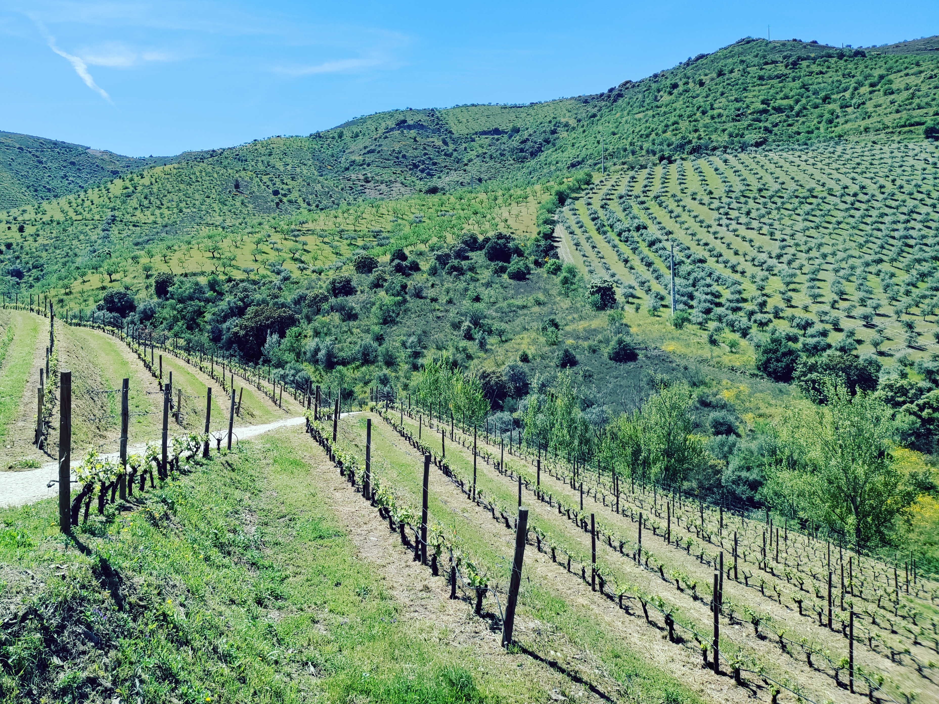
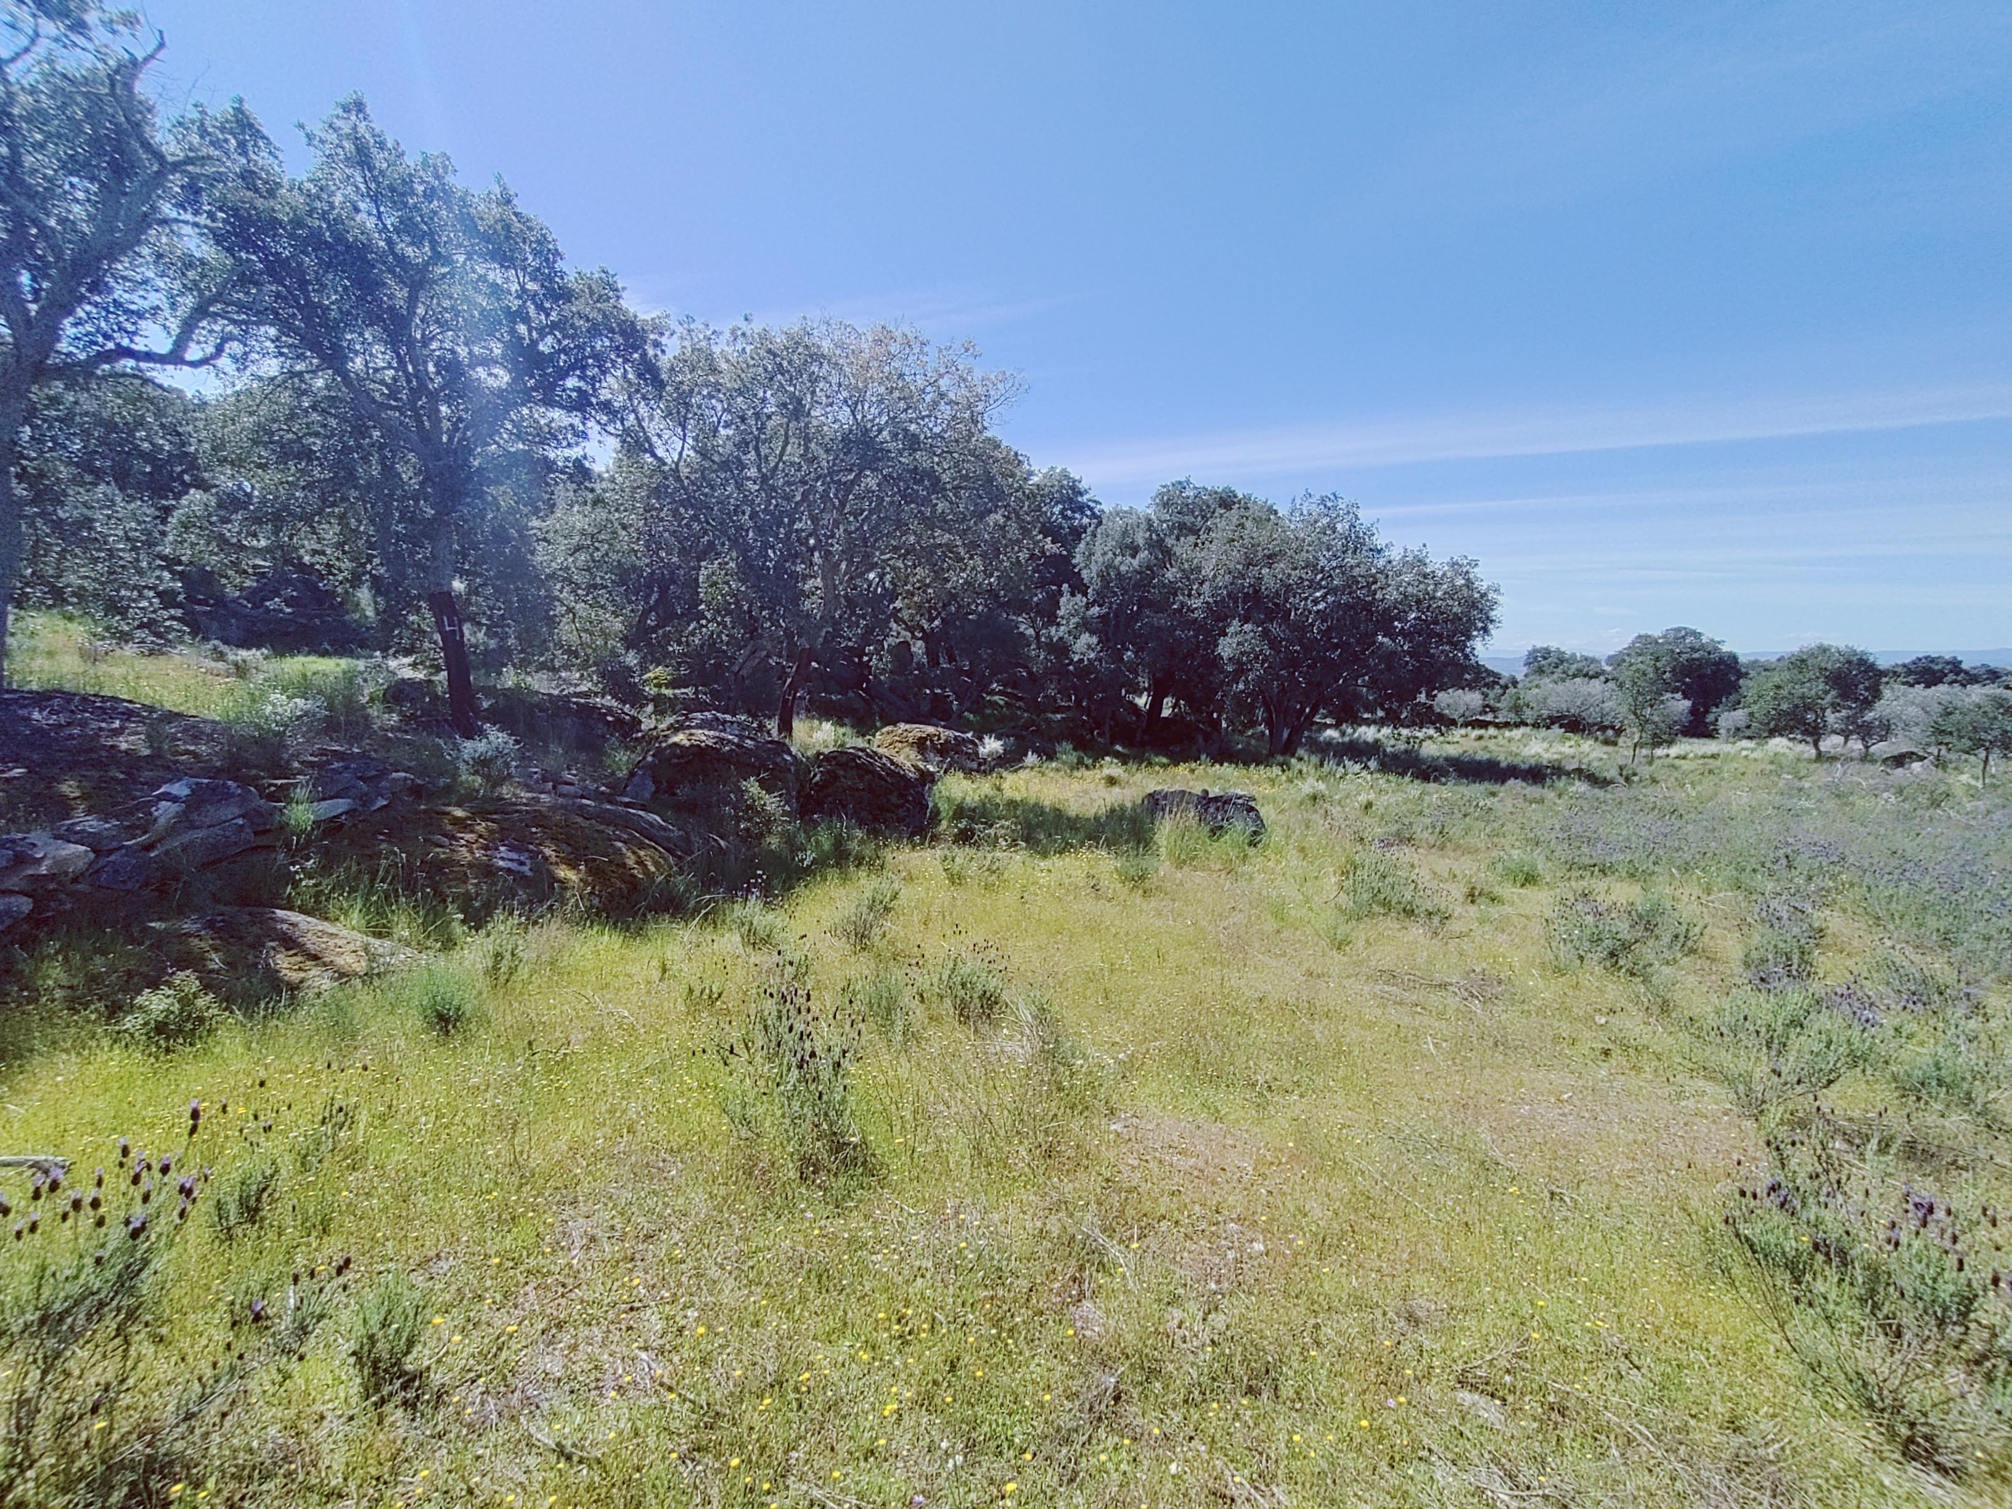
Montados support high plant richness while vineyards provide seasonal nectar peaks
04
Montados: Floristic Reservoirs
Traditional cork-oak forests recorded a mean of 312 plant species. Crucially, they host 78% of the region's native leguminous plants, securing nitrogen fixation in the soil.
Vineyards: Intense Seasonal Peaks
Conventional vineyards had lower cumulative botanical richness (155 species). However, spontaneous vegetation in vineyard ground covers created massive, brief floral resources in late Spring.
Comparison of Nectar Productivity Peaks
Vineyard Inter-rows (Spring Peak)
4.2 floral units / m²
Montados (Stable)
1.2 units / m²
Notes:
SPEAKER NOTES (Slide 4):
• Let's dive into our botanical results.
• Cork-oak montados are the absolute reservoirs of plant diversity in our landscape, hosting a mean of
312 species per plot and, very importantly, 78% of the native legume species which are vital for nitrogen fixation.
• In contrast, conventional intensive vineyards have much lower overall botanical richness, averaging 155 species.
• However, we observed a fascinating phenomenon: when vineyards maintain spontaneous vegetation in their inter-rows,
they produce a massive spring nectar peak—up to 4.2 floral units per square metre, compared to a stable
1.2 in montados. This highlights that agricultural lands can offer vital resources if managed with organic principles.

Slide 5
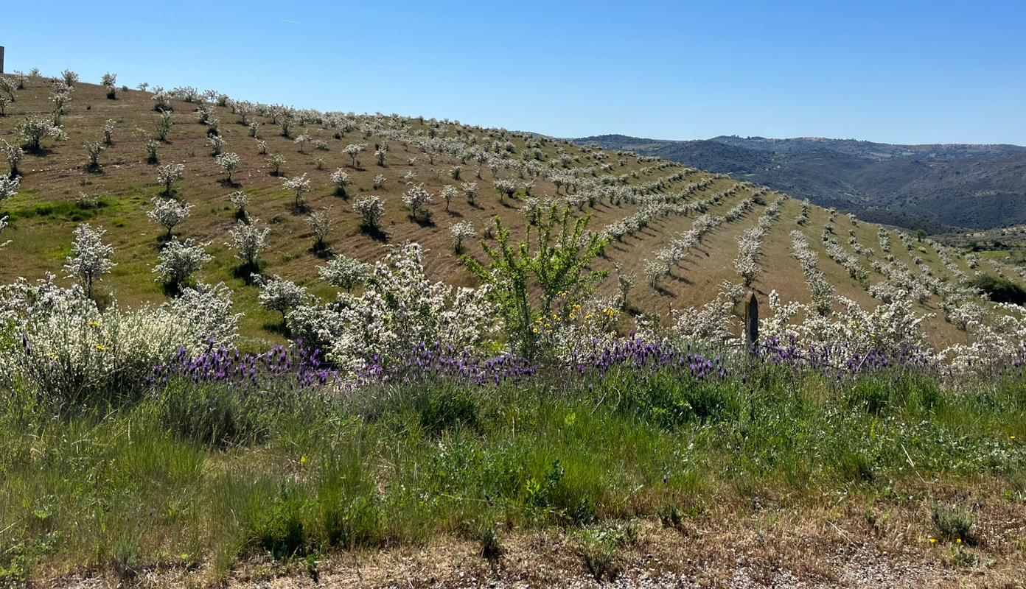
Almond monocultures boost summer ladybirds but stabilise predator equitability
05
Ladybird Surges in Almond Trees
In Summer, conventional almond monocultures recorded an explosive 6-fold surge in predatory ladybirds (reaching an estimated 1,368 individuals per hectare) to feed on aphid outbreaks.
The Collapse of Seasonal Equitability
This single-species explosion led to a worrying collapse in predator community equitability (with Shannon's J index dropping from 0.77 in Spring to 0.41 in Summer) as ladybirds dominated the guild.
⚠️ Ecological Instability Risk:
Without a balanced and diverse predator guild, crops are left highly vulnerable to pest outbreaks in Autumn when ladybirds disperse.
Notes:
SPEAKER NOTES (Slide 5):
• Now, let's examine insect predators, which provide crucial natural pest control.
• In conventional almond orchards, we observed an explosive 6-fold surge of predatory ladybirds in Summer,
reaching 1,368 individuals per hectare. This is a clear response to seasonal aphid outbreaks.
• However, this is not necessarily a sign of a healthy ecosystem. This ladybird monopoly caused a collapse
in the predator community's evenness or equitability, with Shannon's J index skyrocketing from 0.41 to 0.77 when balanced in Spring.
• Monocultures lack the ecological stability to maintain a balanced predator guild year-round.
When ladybirds leave or hibernate in Autumn, the crop is highly vulnerable to subsequent pest invasions.

Slide 6
Insectivorous birds track local prey density rather than formal habitat types
06
The Priority of Prey Availability
Small insectivorous passerines actively tracked local insect abundance across the landscape, ignoring formal land-use designations. Food density was the absolute primary driver of bird foraging.
The Buffer Value of Heterogeneous Mosaics
Complex agricultural mosaics sustained high avian nesting and foraging activity (up to 8 active breeding pairs per hectare), even in plots with minimal mature tree canopy cover.
Key Conservation Finding
Maintaining small pockets of natural scrub and trees within crop fields provides essential shelter, allowing birds to forage deep into commercial cropland.
Notes:
SPEAKER NOTES (Slide 6):
• Moving up the food chain, we studied insectivorous birds (passerines), which are key vertebrate pest regulators.
• We discovered that these birds are highly pragmatic: they actively tracked local insect density rather than
formal habitat classifications. Where there were insects, there were birds.
• More importantly, we found that complex agricultural mosaics were able to support high breeding bird activity—
up to 8 breeding pairs per hectare—even when mature tree cover was sparse.
• This means that maintaining small natural patches, hedge rows, or isolated cork oaks within croplands
is incredibly effective, providing nesting sites from which birds can fly out to hunt crop pests.

Slide 7
Organic montados and varied mosaics maximise landscape connectivity and multifunctionality
07
To measure connectivity, we calculated Sørensen similarity indexes for biological communities across land uses. An NMDS ordination model (stress = 0.11) confirmed that organic systems are the central hubs of multifunctionality.
Landscape / Land Use | Sørensen Index (Connectivity) | Predator-Pollinator Match | Multifunctionality Score
Organic Montados (Cork-Oak) | 0.68 (Highest) | Optimal Co-existence | Excellent (Central Hub)
Mixed Agroecological Mosaics | 0.52 (High) | Strong Seasonal Sync | High (Secondary Hub)
Conventional Intensive Vineyards | 0.39 (Poor) | Severe Seasonal Mismatch | Low (Isolated System)
*Note: Sørensen index measures species similarity (0 to 1). NMDS ordination stress = 0.11 indicating a highly reliable model fit of landscape multifunctionality.
Notes:
SPEAKER NOTES (Slide 7):
• To evaluate how well species move and connect across these habitats, we calculated Sørensen similarity indexes.
• Organic Montados showed the highest community similarity (0.68), acting as central ecological reservoirs.
• When we look at mixed agroecological mosaics, they maintain a solid connectivity index of 0.52,
functioning as strong transitional pathways.
• Conventional vineyards, however, are highly isolated with a similarity of only 0.39.
• We also built a non-metric multidimensional scaling (NMDS) model to evaluate overall multifunctionality.
With a reliable stress value of 0.11, the model mathematically demonstrates that organic systems and
heterogeneous mosaics are the true functional anchors of the Côa Valley.

Slide 8
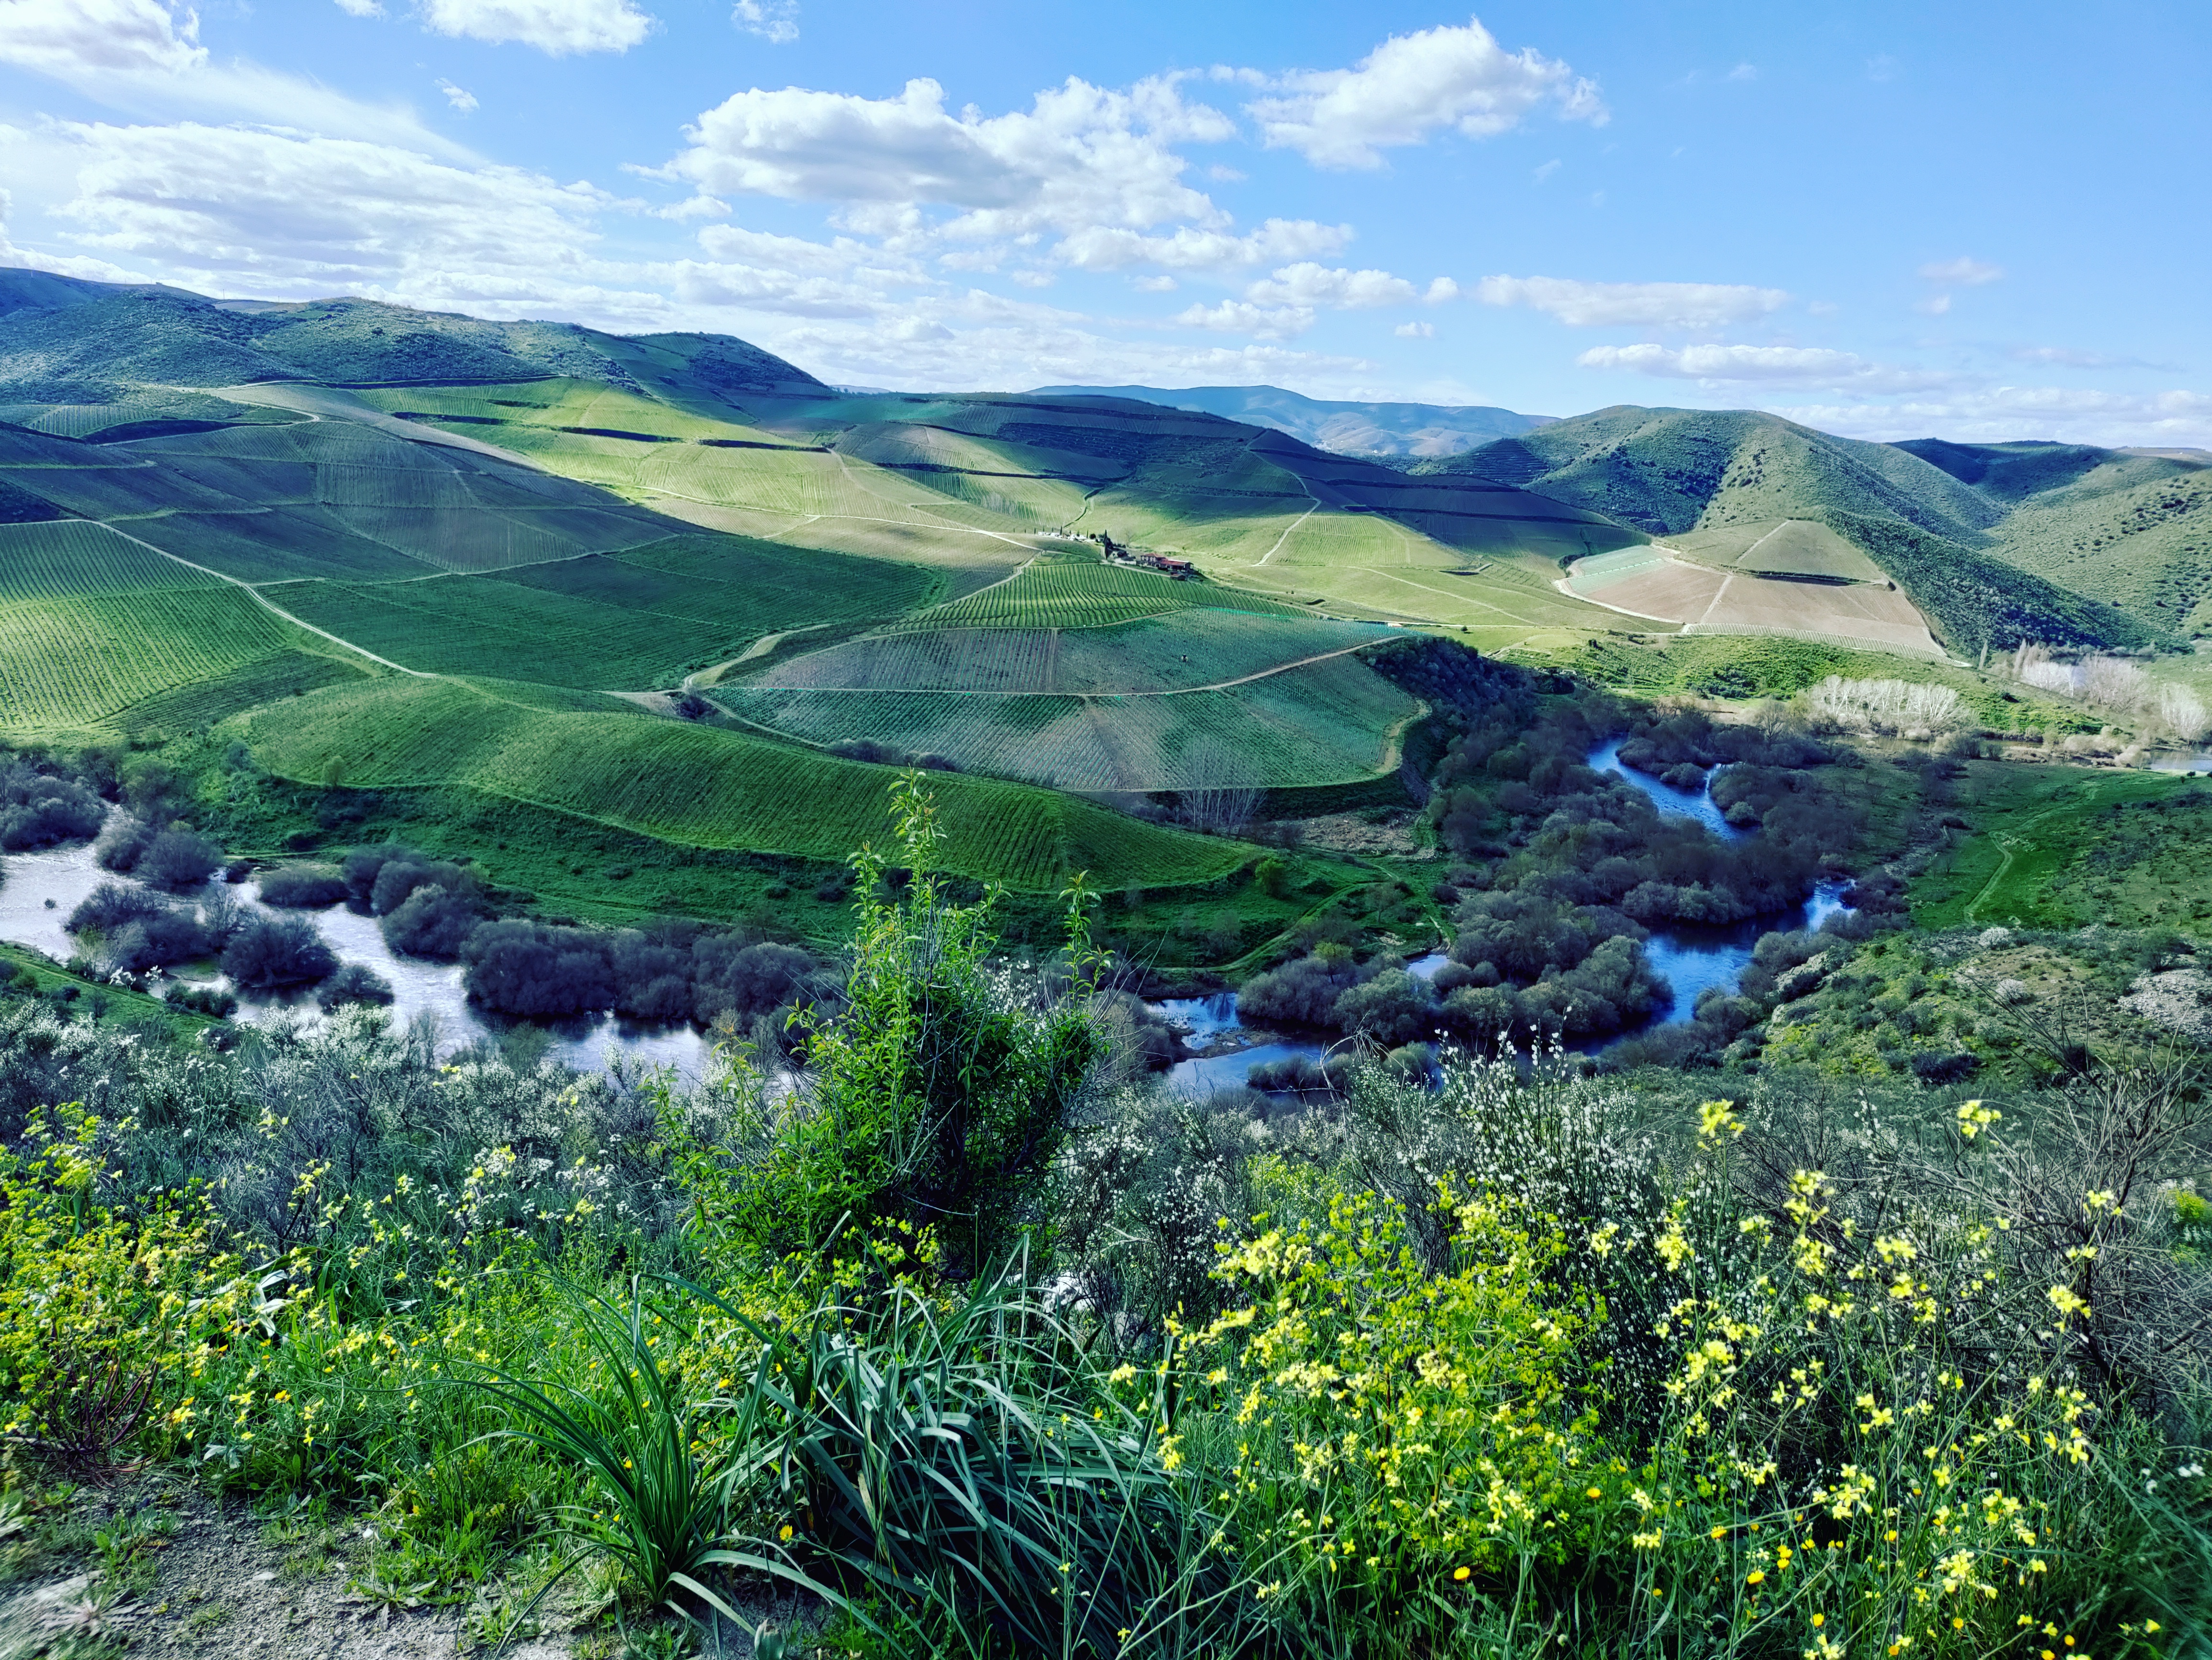
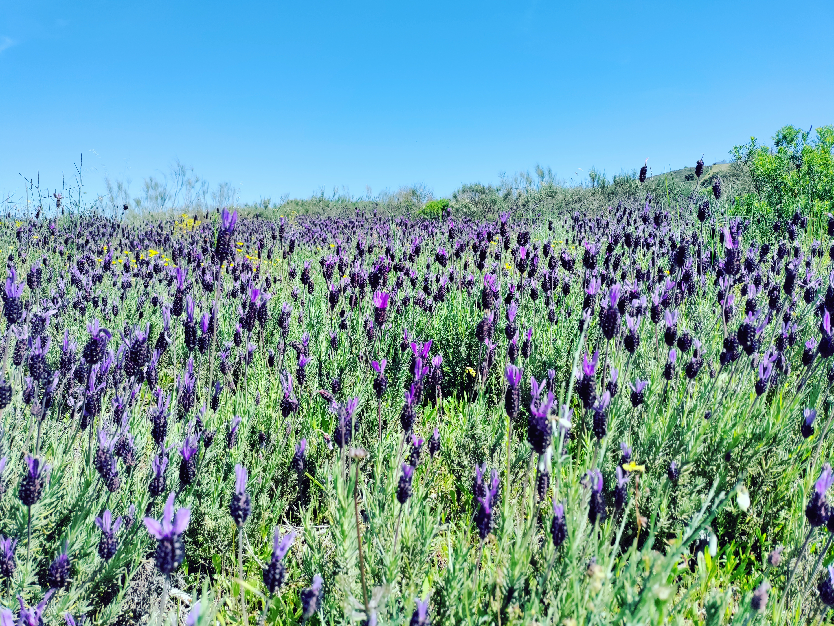
Three targeted management actions reconcile ecological health with farm productivity
09
1. Preserve Small
Montado Patches
• Safeguard Ecological Hubs:
Ensure complete legal protection for remaining isolated patches of old cork-oak woodlands (montados) within commercial farms, maintaining mature tree canopies as vital local wildlife refuges.
2. Restore Riparian
Green Corridors
• Expand Buffer Strips:
Establish and widen vegetated riparian buffer strips along rivers. Restricting pesticide spraying within 10 metres of these riverbanks will protect insect predator reservoirs and enhance water quality.
3. Sowing Cover
Crops in Inter-rows
• Active Understory:
Incentivise farmers to plant biodiverse, native cover crops between rows of grapes and almonds. This simple practice maximises soil health, prevents erosion, and supports massive pollinator peaks.
Notes:
SPEAKER NOTES (Slide 9):
• Based on our ecological results, we propose three practical, action-oriented recommendations for land managers:
• First, preserve small montado patches. Isolated cork-oak stands act as critical ecological stepping stones,
supplying biological resources to neighbouring croplands.
• Second, restore and expand riparian corridors. Widening these green buffer strips and enforcing no-spray zones
within 10 metres of riverbanks will protect water systems and keep pest predators close to fields.
• Third, encourage native cover crops. Planting biodiverse seed mixes between vine and almond rows
replaces bare earth with flower-rich habitats, boosting organic soil carbon and sustaining massive pollinator communities.

Slide 9
10
In Summary:
Managing Mediterranean agricultural landscapes as complex mosaics is a highly viable, scalable Nature-based Solution. Protecting natural fragments, restoring riparian buffer strips, and incentivising organic cover cropping can fully reconcile farming with biodiversity conservation.
Thank you very much for your time!
Questions are welcome.
Contact Email: monicapinto@utad.pt
National Funding Acknowledgements: This work is supported by National Funds by FCT – Portuguese Foundation for Science and Technology, under the projects UID/04033/2025: Centre for the Research and Technology of Agro-Environmental and Biological Sciences and LA/P/0126/2025 (https://doi.org/10.54499/LA/P/0126/2020). Mónica Pinto thanks to FCT funding PRT/BD/154865/2023 (https://doi.org/10.54499/PRT/BD/154865/2023).
Notes:
SPEAKER NOTES (Slide 10):
• To conclude, our research proves that managing Mediterranean farmlands as complex agroecological mosaics
is not just a romantic ideal, but a scientifically validated Nature-Based Solution.
• By implementing target actions—protecting small old forest remnants, restoring riversides, and sowing native cover crops—
we can achieve high agricultural productivity and protect vital biodiversity at the same time.
• I would like to express my gratitude to the Portuguese Science and Technology Foundation (FCT) for funding CITAB and InBIO,
and for supporting my doctoral grant.
• Thank you to all our institutional partners: UTAD, CIBIO, ICNF, and Côa Parque.
• Thank you very much for your attention, and I am now open to any questions you may have.

